Slide 1
Data Structures, Algorithms and Design

Slide 2
Contact Session I

Slide 3
Plan of Lecture
Introduction to the Course
Introduction to the Algorithms
Introduction to the Basic Data Structures

Slide 4
Course Introduction
COURSE DESCRIPTION:
The course covers design, implementation and applications of data structures including trees and graphs. The course covers algorithm design techniques using examples from sorting, searching, graph theory, networking and number theory.
The scope of the designs will include complexity issues and suitability issues.

Slide 5
Course Objectives
CO1 | Introduce mathematical and experimental techniques to analyze algorithms
CO2 | Introduce linear and non-linear data structures and best practices to choose appropriate data structure for a given application
CO3 | Teach various dictionary data structures (Lists, Trees, Heaps) with illustrations on possible representation, various operations and their efficiency
CO4 | Exposes students to various sorting and searching techniques
CO5 | Discuss in detail various algorithm design approaches (Greedy method, divide and conquer, dynamic programming, backtracking, and branch and bound) with appropriate examples, methods to make correct design choice and the efficiency concerns.
CO6 | Introduce complexity classes , notion of NP-Completeness, ways of classifying problem into appropriate complexity class
CO7 | Introduce reduction method to prove a problem’s complexity class.

Slide 6
TEXT BOOK (T):
Algorithms Design: Foundations, Analysis and Internet Examples, by Michael T. Goodrich, Roberto Tamassia, 2006, Wiley (Students Edition)
REFERENCE BOOKS (R):
Data Structures, Algorithms and Applications in C++, Sartaj Sahni, Second Ed, 2005, Universities Press
Cormen T.H., Leiserson, C.E., Rivest, R.L., and C. Stein. Introduction to Algorithms, MIT Press, Second Edition (Indian reprint: Prentice-Hall).

Slide 7
Learning Outcomes
LO1 | Describe various fundamental data structures, their properties, algorithm design techniques and various means of evaluating algorithms
LO2 | Demonstrate the ability to evaluate algorithms, to select from a range of possible options, to provide justification for that selection, and to implement the algorithm in a particular context.
LO3 | Solve problems using Algorithms for Linear and Non-Linear Data Structures, Graph algorithms (Shortest Paths Algorithms, Connectivity and Reachability Algorithms, Spanning Trees)
LO4 | Explain with a practical example, each of the algorithm design strategies (brute-force, greedy, divide-and-conquer, recursive backtracking, and dynamic programming)
LO5 | Use brute-force, greedy, divide-and-conquer, recursive backtracking, and dynamic programming techniques to solve a given algorithm design problem.
LO6 | Relate the real-world problems to known data structures and algorithms leading to the recommend appropriate solutions in representation and implementation.
LO7 | Explain the significance of NP-completeness
LO8 | Classify problems into complexity classes P and NP and to prove hardness of problems

Slide 8
EVALUATION SCHEME
Evaluation Component | Name (Quiz, Lab, Project, Midterm exam, End semester exam, etc) | Type (Open book, Closed book, Online, etc.) | Weight | Duration | Day, Date, Session, Time
EC - 1 | Quiz-I/ Assignment-I | Online | 5% | - | September 10-20, 2020
 | Quiz-II | Online | 5% | - | October 20-30, 2020
 | Quiz-III/ Assignment-II | Online | 5% | - | November 10-20, 2020
EC - 2 | Mid-term Exam | Closed book | 35% | 2 hours | Saturday, 10/10/2020 (FN) 10 AM - 12 Noon
EC - 3 | End Semester Exam | Open book | 50% | 3 hours | Saturday, 28/11/2020 (FN) 9 AM – 12 Noon

Slide 10
Data Structures, Algorithms and Design
Module 1

Slide 11
ALGORITHM
A well-defined computational procedure that takes some value, or a set of values, as input and produces some value, or a set of values, as output.
It can also be defined as sequence of computational steps that transform the input into the output.

Slide 12
Algorithms and it’s Specification
All algorithms must satisfy the following criteria:
Input. There are zero or more quantities that are externally supplied.
Output. At least one quantity is produced.
Definiteness. Each instruction is clear and unambiguous.
Finiteness. If we trace out the instructions of an algorithm, then for all cases, the algorithm terminates after a finite number of steps.
Effectiveness. Every instruction must be basic enough to be carried out, in principle, by a person using only pencil and paper. It is not enough that each operation be definite as in (3); it also must be feasible.

Slide 13
Algorithms and it’s Specification
The specification is the process of conversion of solution into an algorithm.
Done in 3 ways:
Natural language
Flowchart
Pseudo Code

Slide 14
EFFICIENCY OF AN ALGORITHM
Complexity of algorithm is a function of size of input of a given problem instance which determines how much running time/memory space is needed by the algorithm in order to run to completion.
Time Complexity: Time complexity of an algorithm is the amount of time it needs in order to run to completion.
Space Complexity: Space Complexity of an algorithm is the amount of space it needs in order to run to completion.
There are two points which we should consider about computer programming:-
An appropriate data structure and
An appropriate algorithm.

Slide 15
EFFICIENCY OF AN ALGORITHM
It can be of various types:
Worst case efficiency: It is the maximum number of steps that an algorithm can take for any collection of data values.
Best case efficiency: It is the minimum number of steps that an algorithm can take any collection of data values.
Average case efficiency: It can be defined as
the efficiency averaged on all possible inputs
must assume a distribution of the input
We normally assume uniform distribution (all keys are equally probable)
If the input has size n, efficiency will be a function of n

Slide 16
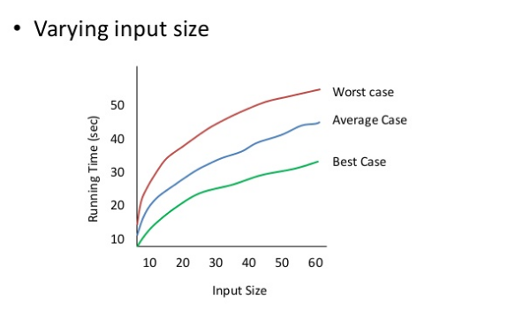
EFFICIENCY OF AN ALGORITHM

Slide 17
Examples
Average in increasing order of the occurrence of number (in ONE loop)
INPUT
OUTPUT
2 | 6 | 4 | 8 | 3 | 8 | 14 | 24 | 54 | 76 | 21 | 87 | 95 | 2 | 45
2 | 8 | 12 | 20 | 23 | 31 | 45 | 69 | 123 | 199 | 220 | 307 | 402 | 404 | 449

Slide 18
Use of Prefix average:
Prefix Averages
Given an array X storing n numbers
We want to compute an array A such that A[i] is the average of elements uptill “i”.
Application
Economics and statistics (year by year update)
“Smoothing" function for a parameter that is quickly changing

Slide 19
Example: Normal Way of solving
Algorithm prefixAveragesl(X):
Input: An n-element array X of numbers.
Output: An n-element array A of numbers such that A [i] is the average of elements X {0],. . . , X [i].
Let A be an array of n numbers.
For i ← 0 to n-1 do
a ← 0
For j ← 0 to i do
a ← a+X[j]
A[i] ← a/(i+1)
return array A

Slide 20
Example: Normal Way of solving
Algorithm prefixAveragesl(X):
Input: An n-element array X of numbers.
Output: An n-element array A of numbers such that A [i] is the average of elements X {0],. . . , X [i].
Let A be an array of n numbers.
For i ← 0 to n-1 do
a ← 0
For j ← 0 to i do
a ← a+X[j] executes 1+2+3+……n times→n(n+1)/2 times
A[i] ← a/(i+1)
return array A So the running time is O(n²)

Slide 21
Example: Better Way of solving
Algorithm prefixAveragesl(X):
Input: An n-element array X of numbers.
Output: An n-element array A of numbers such that A [i] is the average of elements X {0],. . . , X [i].
Let A be an array of n numbers.
For i ← 0 to n-1 do
a ← 0
For j ← 0 to i do
a ← a+X[j]
A[i] ← a/(i+1)
return array A
calculate the sum every time increase complexity
We need to get rid of the loop

Slide 22
Example: Better Way of solving
Algorithm prefixAverages_lI(X):
Input: An n-element array X of numbers.
Output: An n-element array A of numbers such that A [i] is the average of elements X {0],. . . , X [i].
Let A be an array of n numbers.
For i ← 0 to n-1 do
s←s+X[i]
A[i] ←s/(i+1)
return array A

Slide 23
Some More Examples:
To find the Max/Min element for the:
Sorted Array
Unsorted Array
To find the Second Max/Min element for the:
Sorted Array
Unsorted Array
To find the Third Max/Min element for the:
Sorted Array
Unsorted Array
2 | 6 | 4 | 8 | 3 | 8 | 14 | 24 | 54 | 76 | 21 | 87 | 95 | 2 | 45

Slide 24
Some More Examples:
To find the Max/Min element for the:
Want to travers only half a list. (can also be used for top 2)
Using two pointers & traversing with the jump of 1.
Want to travers only one-third of the list. (can also be used for top 3)
Using three pointers & traversing with the jump of 2.
…….
2 | 6 | 4 | 8 | 3 | 8 | 14 | 24 | 54 | 76 | 21 | 87 | 95 | 2 | 45

Slide 25
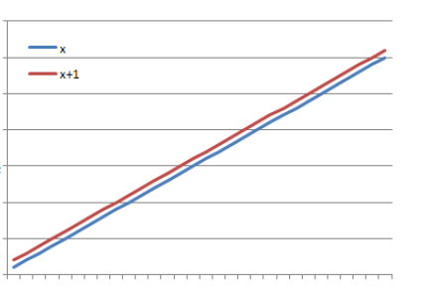
ASYMPTOTIC NOTATIONS
Asymptotic
It means a line that continually approaches a given curve but does not meet it at any finite distance.
Example
(x) is asymptotic with (x + 1) as shown in graph.

Slide 26
ASYMPTOTIC NOTATIONS
Asymptotic may also be defined as a way to describe the behaviour of functions in the limit or without bounds.
Let f(x) and g(x) be two functions of real numbers.
We say that f and g are asymptotic and write f(x) ≈ g(x) if

Slide 27
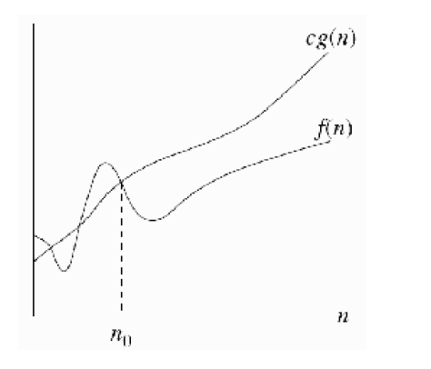
ASYMPTOTIC NOTATIONS
If f(n) = O(g(n)), we say that g(n) is an upper bound on f(n).

Slide 28
ASYMPTOTIC NOTATIONS
Examples –
F (n) = 3n + 2
= 3n+2 as 3n+2 <= 4n for n >=2
= Ο(n)
2) F (n) = 100n +6
= 100n +6 as 100n + 6 <=101n for n>=6
= Ο(n)
3) F (n) = 1000n² + 100n - 6
as 1000n² + 100n - 6 <= 1001n² for n>=100
= Ο(n²)

Slide 29
Corollary:
K*f(n) is O(f(n)) [i.e., constant coefficients can be dropped]
G(n) = 7n⁴ is O(n⁴)
That is, if we have a function multiplied by a constant, we can ignore the constant in the big-O.

Slide 30
Theorem 1 –
Let f₁(x) be O(g₁(x)) and f₂(x) be O(g₂(x)). Then f₁(x)+f₂(x) is O( max(|g₁(x)|,|g₂(x)|) ).
Proof –
There exist k₁,k₂,c₁,c₂, s.t.
|f₁(x)| ≤ c₁|g₁(x)| for all x > k₁, and
|f₂(x)| ≤ c₂|g₂(x)| for all x > k₂
– By the triangle inequality,
|f₁(x)+f₂(x)| ≤ |f₁(x)| + |f₂(x)|
≤ c₁|g₁(x)| + c₂|g₂(x)| for all x > max(k₁, k₂)
≤ c₁ max(|g₁(x)|,|g₂(x)|) + c₂max(|g₁(x)|,|g₂(x)|)
≤ (c₁ + c₂) |max( |g₁(x)|, |g₂(x)| ) |
– Using c = c₁ + c₂, and k = max(k₁, k₂), we have that
f₁(x)+f₂(x) is O( max( |g₁(x)|, |g₂(x)| ) ).

Slide 31
Theorem 2
Let f(x) = a_{n}x^{n} + a_{n-1}x^{n-1} + … + a₁x + a₀, where ∀i (a_{i}∈R). Then f(x) is O(x^{n}).
Proof
For this proof, we will assume the “triangle inequality”
∀x∀y ( |x+y| ≤ |x| + |y| ).
Using this property,
|f(x)| ≤ | a_{n}x^{n} | + | a_{n-1}x^{n-1} | + … + |a₁x| + |a₀|
= x^{n}(|a^{n}| + |a_{n-1}|/x + … + |a₁|/x^{n-1} + |a₀|/x^{n})
≤ x^{n}(|a_{n}| + |a_{n-1}| + … + |a₁| + |a₀|) for x > 1
– So using c = |a_{n}| + |a_{n-1}| + … + |a₁| + |a₀| and k = 1 gives
∀x ( (x > k) → ( |f(x)| ≤ c|g(x)| ) ),
completing the proof.

Slide 32
ASYMPTOTIC NOTATIONS
Big-Omega Notation (Ω)
It provides possibly asymptotically tight lower bound for f(n) and it does not give worst case complexity but can give best case complexity
f(n) = Ω(g(n)), iff there are positive constants c and n₀ such that
0 ≤ c g(n) ≤ f(n) for all n ≥ n₀

Slide 33
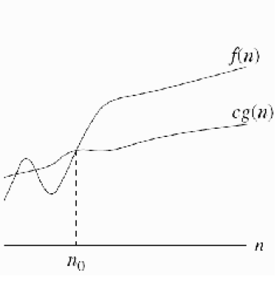
ASYMPTOTIC NOTATIONS
If f(n) = Ω(g(n)), we say that g(n) is a lower bound on f(n).

Slide 34
ASYMPTOTIC NOTATIONS
Examples –
F (n) = 3n+2
= 3n+2 as 3n+2 >= 3n for n >=1
= Ω (n)
2) F (n) = 100n + 6
= 100n + 6 as 100n + 6 >=100n for n>=1
= Ω (n)
3) F (n) = 1000n² + 100n - 6
as 1000n² + 100n -6 >= 1000n² for n>=1
= Ω (n²)

Slide 35
f(n) is not Og(n)
f(n)=n² & g(n)=n;
f(n) is Ω(g(n)), but f(n) is NOT O(g(n))
f(n)=n³ & g(n)= n² ;
f(n) is Ω(g(n)), but f(n) is NOT O(g(n))
f(n)=n and g(n)=n^{(1 + sin(x))}.
f(n) is not O(g(n)) and g(n) is not O(f(n))

Slide 36
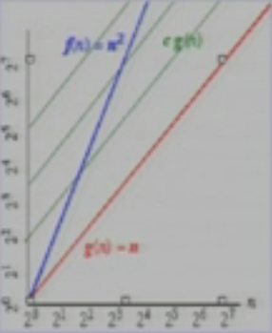
f(n) is not Og(n)
f(n)=n² & g(n)=n
There is no c and n₀ such that n² <= cn for n>= n₀
For every large c is chosen there is an n big enough that n² >cn

Slide 37
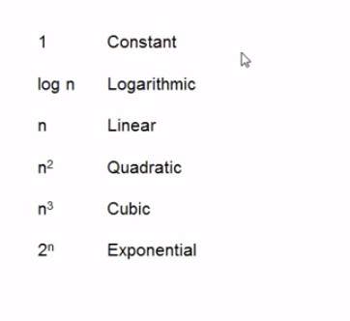
Running Time
Time complexity are generally of the order of below types :-

Slide 38
The Growth Rate of the Six Popular functions
n | logn | n | nlogn | n² | n³ | 2^{n}
4 | 2 | 4 | 8 | 16 | 64 | 16
8 | 3 | 8 | 24 | 64 | 512 | 256
16 | 4 | 16 | 64 | 256 | 4,096 | 65,536
32 | 5 | 32 | 160 | 1,024 | 32,768 | 4,294,967,296
64 | 6 | 64 | 384 | 4,094 | 262,144 | 1.84 * 10¹⁹
128 | 7 | 128 | 896 | 16,384 | 2,097,152 | 3.40 * 10³⁸
256 | 8 | 256 | 2,048 | 65,536 | 16,777,216 | 1.15 * 10⁷⁷
512 | 9 | 512 | 4,608 | 262,144 | 134,217,728 | 1.34 * 10¹⁵⁴
1024 | 10 | 1,024 | 10,240 | 1,048,576 | 1,073,741,824 | 1.79 * 10³⁰⁸

Slide 39
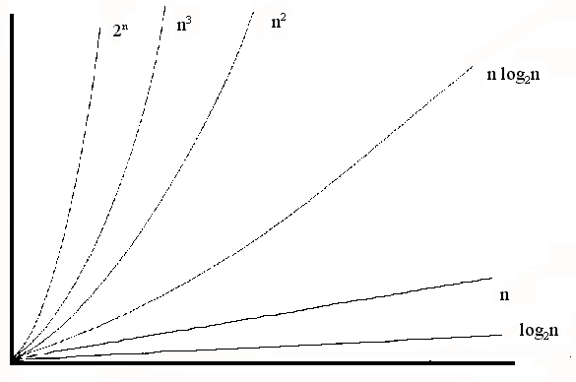
Common growth rates

Slide 40
Another Method to calculate Complexity

Slide 41
Random Access Machine model
Algorithms can be measured in a machine-independent way using the Random Access Machine (RAM) model.
This model assumes a single processor.
In the RAM model, instructions are executed one after the other, with no concurrent operations.
This model of computation is an abstraction that allows us to compare algorithms on the basis of performance.

Slide 42
Random Access Machine model
The assumptions made in the RAM model to accomplish this are:
Each simple operation takes 1 time step.
Loops and subroutines are not simple operations.
Each memory access takes one time step, and there is no shortage of memory.
For any given problem the running time of an algorithms is assumed to be the number of time steps. The space used by an algorithm is assumed to be the number of RAM memory cells.

Slide 43
Random Access Machine model
A set of high-level primitive operations that are largely independent from the programming language used and can be identified also in the pseudo-code.
Primitive operations include the following: -
Assigning a value to a variable
Calling a method
Performing an arithmetic operation (for example, adding two numbers).
Comparing two numbers
Indexing, into an array
Following an object reference
Returning, from a method.

Slide 44
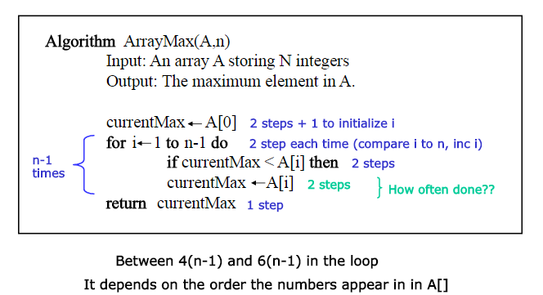
Counting Primitive Operations

Slide 45
Counting Primitive Operations
Total Count(Best and Worst Case) :-
The number of primitive operations t(n) executed by algorithm arrayMax is at least :-
2+1+n+4(n-1)+1=5n
and at most:-
2+1+n+6(n-1)+1=7n-2.
The best case (t(n) = 5n) occurs when A[O] is the maximum element, so that variable currentMax is never reassigned.
The worst case (t(n) = 7n - 2) occurs when the elements are sorted in increasing order, so that variable currentMax is reassigned at each iteration of the for loop.

Slide 46
Counting Primitive Operations
How ?
Before loop:-
Initializing the variable currentMax to A [O] - 2 steps
Initializing of variable i to 1 - 1 step
Comparing two variables i < n - n steps ( loop condition)
Within loop :-
Incrementing i - 2 steps
Comparing currentMax < A[i] - 2 steps
Initializing the variable currentMax to A [i] - 2 steps ( only executed if A[i] > currentMax ); never executed in best case scenario
After loop:-
Return currentMax - 1 step

Slide 47
HomeWork_1
How will you write a simple algorithm to find sum of N natural numbers from 1 to N ?
Write code/algorithm for above and count the number of primitive operations that it does.
Is there any scope of improvement in your algorithm here ?

Slide 48
Problem to solve
Collapse problem (“in ONE loop”)
INPUT
OUTPUT
A |  | B |  |  | C |  | D |  |  | E |  |  |  | F |  |  | G
 |  |  |  |  |  |  |  |  |  |  |  |  | A | B | C | D | E | F | G

Slide 49
Recurrences

Slide 50
Recurrences
Recurrences: The Divide and Conquer approach leads to Recurrence Formulae to represent its time costs:
For Base case (1 is typical, but we could have n larger) T(n) = Θ(1).
For large(r) values of n, T(n) = a T(n/b) + f(n), where f(n) represents the costs of dividing and those of recombining the solutions.

Slide 51
Recurrences
The substitution method: essentially, guess the solution and prove the guess to be correct by mathematical induction. This will work well in all cases. Slight difficulty: you have to guess right – and that is not easy in most cases…
The recursion-tree method: convert the recurrence into a tree (as in MERGESORT) and add up all the costs of each level, and then add up the costs of all the levels. Slight difficulty: unless the costs at each level are easy to compute, you may have some difficult bounds to cook up.
The Master Method: there is a theorem... Basically, find out which set of hypotheses hold in your special case, and read off the conclusion. Slight difficulty: sometimes you will have trouble proving that the hypotheses you need (or any relevant hypotheses) are actually satisfied.

Slide 52
Iterative Substitution
In the iterative substitution, or “plug-and-chug,” technique, we iteratively apply the recurrence equation to itself and see if we can find a pattern:
Note that base, T(n)=b, case occurs when 2^{i}=n. That is, i = log n.
So,
Thus, T(n) is O(n log n).

Slide 53
Substitution Method
Guess the form of the solution, then use mathematical induction to show it correct.
Substitute guessed answer for the function when the inductive hypothesis is applied to smaller values – hence, the name.
Works well when the solution is easy to guess.
No general way to guess the correct solution.
Notes:
Talk about how mathematical induction works.

Slide 54
Example – Exact Function
Recurrence: T(n) = 1 if n = 1
T(n) = 2T(n/2) + n if n > 1
Guess: T(n) = n lg n + n.
Induction:
Basis: n = 1 ⇒ n lgn + n = 1 = T(n).
Hypothesis: T(k) = k lg k + k for all k < n.
Inductive Step: T(n) = 2 T(n/2) + n
= 2 ((n/2)lg(n/2) + (n/2)) + n
= n (lg(n/2)) + 2n
= n lg n – n + 2n
= n lg n + n

Slide 55
Example
Recurrence:
$$T \left(n\right)=2T\left(n−1\right)+n is O(n^{2})$$
$$T\left(n\right)=T(\left\lceil n/2\right\rceil )+1 is O (\lg{n)}$$

Slide 56
Recursion-tree Method
Making a good guess is sometimes difficult with the substitution method.
Use recursion trees to devise good guesses.
Recursion Trees
Show successive expansions of recurrences using trees.
Keep track of the time spent on the subproblems of a divide and conquer algorithm.
Help organize the algebraic bookkeeping necessary to solve a recurrence.

Slide 57
The Recursion Tree
Draw the recursion tree for the recurrence relation and look for a pattern:
depth | T’s | size
0 | 1 | n
1 | 2 | n/2
i | 2^{i} | n/2^{i}
… | … | …
time
bn
bn
bn
…
Total time = bn + bn log n
(last level plus all previous levels)

Slide 58
Guess-and-Test Method
In the guess-and-test method, we guess a closed form solution and then try to prove it is true by induction:
Guess: T(n) < cn log n.
Wrong: we cannot make this last line be less than cn log n

Slide 59
Guess-and-Test Method, Part 2
Recall the recurrence equation:
Guess #2: T(n) < cn log² n.
if c > b.
So, T(n) is O(n log² n).
In general, to use this method, you need to have a good guess and you need to be good at induction proofs.

Slide 60
Master Method (Appendix)
Many divide-and-conquer recurrence equations have the form:
The Master Theorem:

Slide 61
Step By Step guide
Extract a, b, f(n).
a>=1.
b>1.
f(n) = Some function of n.
Determine $n^{\log_{b}(a)}$.
Compare f(n) and $n^{\log_{b}(a)}$ asymptotically.
Determine which case of master method satisfies.
If $n^{\log_{b}(a)}$ is polynomially asymptotically larger then f(n) then CASE I
The running time is dominated by the cost at the leaves
If $n^{\log_{b}(a)}$ is polynomially asymptotically smaller then f(n) then CASE III
The running time is dominated by the cost at the root
If $n^{\log_{b}(a)}$ is polynomially asymptotically equal then f(n) then CASE II
The running time is evenly distributed throughout the tree.

Slide 62
Master Method, Example 1
The form:
The Master Theorem:
Example:
Solution: log_{b}a=2, so case 1 says T(n) is O(n²).

Slide 63
Master Method, Example 2
The form:
The Master Theorem:
Example:
Solution: Since n² = Θ(n²) we have T(n) = (n² lg n).

Slide 64
Master Method, Example 3
The form:
The Master Theorem:
Example:
Solution: Since n³ = Ω ($n^{2+∈}$) and 4(n/2)³ = 1/2n³ <= cn³ for some c < 1 we
have that T(n) = Θ(n³).

Slide 65
Master Method, Example 4
The form:
The Master Theorem:
Example:
Solution: log_{b}a=1, so case 2 says T(n) is O(n log² n).

Slide 66
Master Method, Example 5
The form:
The Master Theorem:
Example:
Solution: log_{b}a=0, so case 3 says T(n) is O(n log n).

Slide 67
Master Method, Example 6
The form:
The Master Theorem:
Example:
Solution: log_{b}a=3, so case 1 says T(n) is O(n³).

Slide 68
Master Method, Example 7
The form:
The Master Theorem:
Example:
Solution: log_{b}a=2, so case 3 says T(n) is O(n³).

Slide 69
Master Method, Example 8
The form:
The Master Theorem:
Example:
(binary search)
Solution: log_{b}a=0, so case 2 says T(n) is O(log n).

Slide 70
Master Method, Example 9
The form:
The Master Theorem:
Example:
(heap construction)
Solution: log_{b}a=1, so case 1 says T(n) is O(n).

Slide 71
Proof of correctness

Slide 72
Module II & III
Linear & Non Linear Data Structure

Slide 73
Plan of Lecture
Linear Data Structure
Stacks
Queues
Non Linear Data Structure
Trees
Heap

Slide 74
Stacks
Stacks

Slide 75
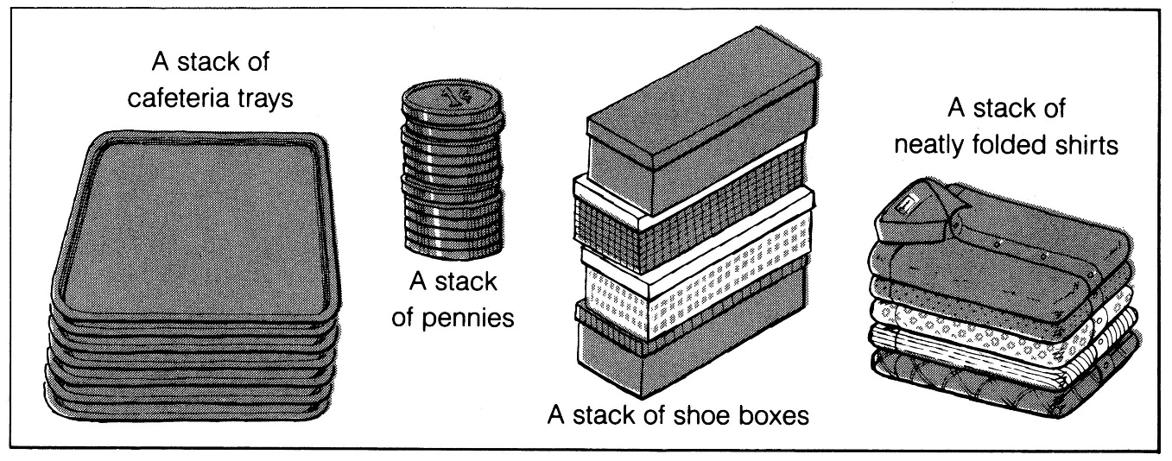
What is a stack?
It is an ordered group of homogeneous items of elements.
Elements are added to and removed from the top of the stack (the most recently added items are at the top of the stack).
The last element to be added is the first to be removed (LIFO: Last In, First Out).

Slide 76
Stack Specification
Definitions: (provided by the user)
MAX_ITEMS: Max number of items that might be on the stack
ItemType: Data type of the items on the stack
Operations
MakeEmpty
Boolean IsEmpty
Boolean IsFull
Push (ItemType newItem)
Pop (ItemType& item)

Slide 77
Operations on stack
Push (ItemType newItem)
Function: Adds newItem to the top of the stack.
Preconditions: Stack has been initialized and is not full.
Postconditions: newItem is at the top of the stack.
Pop (ItemType& item)
Function: Removes topItem from stack and returns it in item.
Preconditions: Stack has been initialized and is not empty.
Postconditions: Top element has been removed from stack and item is a copy of the removed element.

Slide 78
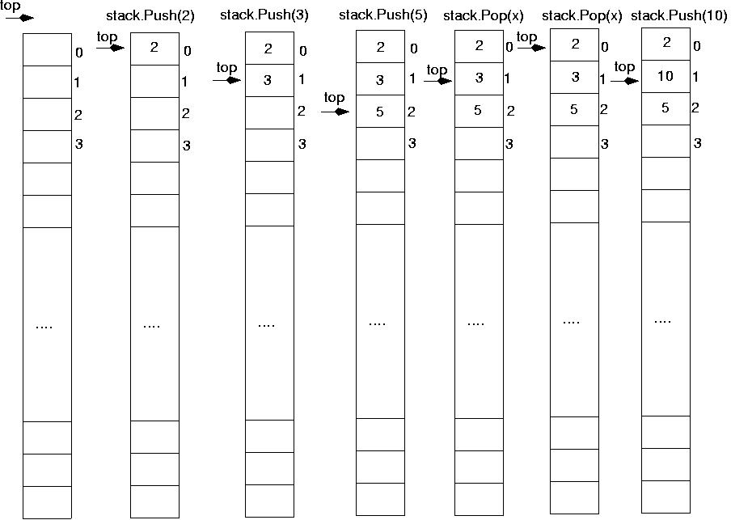
Operations on stack

Slide 79
Stack Implementation
#include "ItemType.h"
// Must be provided by the user of the class
// Contains definitions for MAX_ITEMS and ItemType
class StackType {
public:
StackType();
void MakeEmpty();
bool IsEmpty() const;
bool IsFull() const;
void Push(ItemType);
void Pop(ItemType&);
private:
int top;
ItemType items[MAX_ITEMS];
};

Slide 80
Stack Implementation
StackType::StackType()
{
top = -1;
}
void StackType::MakeEmpty()
{
top = -1;
}
bool StackType::IsEmpty() const
{
return (top == -1);
}

Slide 81
Stack Implementation
bool StackType::IsFull() const
{
return (top == MAX_ITEMS-1);
}
void StackType::Push(ItemType newItem)
{
top++;
items[top] = newItem;
}
void StackType::Pop(ItemType& item)
{
item = items[top];
top--;
}

Slide 82
Exceptions:
Stack overflow
The condition resulting from trying to push an element onto a full stack.
if(!stack.IsFull())
stack.Push(item);
Stack underflow
The condition resulting from trying to pop an empty stack.
if(!stack.IsEmpty())
stack.Pop(item);

Slide 83
Implementation of Stack
Array
Link List

Slide 84
Example: postfix expressions
Postfix notation is another way of writing arithmetic expressions.
In postfix notation, the operator is written after the two operands.
infix: 2+5 postfix: 2 5 +
Expressions are evaluated from left to right.
Precedence rules and parentheses are never needed!!

Slide 85
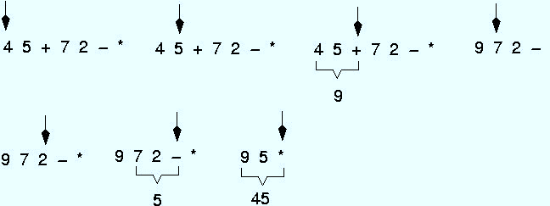
Example: postfix expressions (cont.)

Slide 86
Stack Applications
Stacks are a very common data structure
Compilers
Parsing data between delimiters (brackets)
Operating Systems
Program stack
Virtual Machines
Manipulating numbers
Pop 2 numbers off stack, do work (such as add)
Push result back on stack and repeat
Artificial Intelligence
Finding a path

Slide 87
Finding a Path
Consider the following graph of flights
Z
Key
: city (represented as C)
: flight from city C₁ to city C₂
Y
C₁ C₂
W
S
R
P
T
Example
flight goes from W to S
W
S
X
Q

Slide 88
Finding a Path
If it exists, we can find a path from any city C₁ to another city C₂ using a stack
place the starting city on the bottom of the stack
mark it as visited
pick any arbitrary arrow out of the city
city cannot be marked as visited
place that city on the stack
also mark it as visited
if that’s the destination, we’re done
otherwise, pick an arrow out of the city currently at
next city must not have been visited before
if there are no legitimate arrows out, pop it off the stack and go back to the previous city
repeat this process until the destination is found or all the cities have been visited

Slide 89
Stack is used for:
Page-visited history in a Web browser
Undo sequence in a text editor
Saving local variables when one function calls another, and this one calls another

Slide 90
Stack Summary
Stack Operation Complexity for Different Implementations
Operation | Array Fixed-Size | Array Expandable (doubling strategy) | List Singly-Linked
Pop() | O(1) | O(1) | O(1)
Push(o) | O(1) | O(n) Worst Case O(1) Best Case O(1) Average Case | O(1)
Top() | O(1) | O(1) | O(1)
Size(), isEmpty() | O(1) | O(1) | O(1)

Slide 91
Queues

Slide 92
Queues
A queue is a linear list of elements in which deletion can take place only at one end, called the front, and insertions can take place only at the other end, called the rear.
Queue is also called first-in-first-out (FIFO) lists

Slide 93
Queues
There are main two ways to implement a queue :
Circular queue using array
Linked Structures (Pointers)
Primary queue operations:
Enqueue: insert an element at the rear of the queue
Dequeue: remove an element from the front of the queue

Slide 94
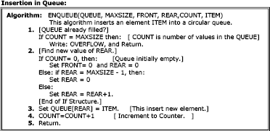
Insertion in Queue (Enqueue)

Slide 95
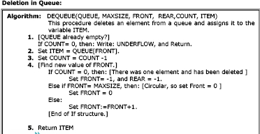
Deletion from Queue (Dequeue)

Slide 96
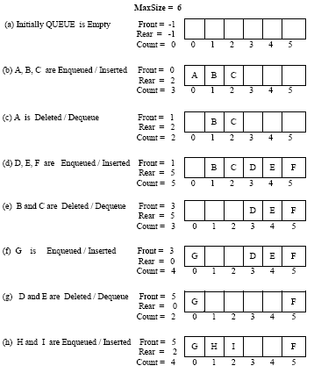

Slide 97
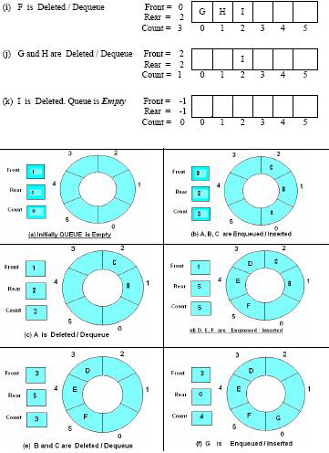

Slide 98
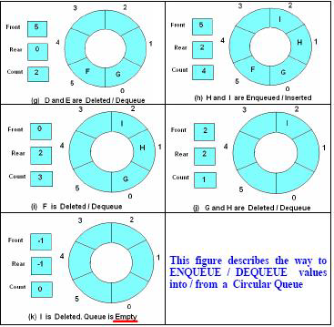

Slide 99
Queue Summary
Queue Operation Complexity for Different Implementations
 | Array Fixed-Size | Array Expandable (doubling strategy) | List Singly-Linked
dequeue() | O(1) | O(1) | O(1)
enqueue(o) | O(1) | O(n) Worst Case O(1) Best Case O(1) Average Case | O(1)
front() | O(1) | O(1) | O(1)
Size(), isEmpty() | O(1) | O(1) | O(1)

Slide 100
Implementing a queue using two stacks (method 1)
Maintain two stacks first and second.
Enqueue operation:
Simply push the elements into the first stack.
Dequeue operation:
Pop from the second stack if the second stack is not empty.
If second stack is empty,
pop from the first stack and push all the elements into second until the first stack becomes empty.
Now pop an element from the second stack and return it.

Slide 101
Implementing a queue using two stacks (method 2)
Maintain two stacks first and second.
Enqueue operation:
While first stack is not empty,
push everything from first stack to second stack.
Push the element to first stack).
Push everything back to first stack.
Dequeue operation:
If first stack is empty then error
Pop an item from first stack and return it
The previous method is better as in this we need to moves all the elements twice in EnQueue operation while we need to moves the elements once and moves elements only if second stack is empty

Slide 102
Implement stack using two queues
Maintain two queues ‘q1′ and ‘q2′ and s is the stack
push(s, x)
Enqueue x to q2
One by one dequeue everything from q1 and enqueue to q2.
Swap the names of q1 and q2 // Swapping of names is done to avoid one more movement of all elements from q2 to q1.
pop(s)
Dequeue an item from q1 and return it.

Slide 103
Implement stack using two queues
Maintain two queues ‘q1′ and ‘q2′ and s is the stack
push(s, x)
Enqueue x to q1.
pop(s)
One by one dequeue everything except the last element from q1 and enqueue to q2.
Dequeue the last item of q1, the dequeued item is result, store it.
Swap the names of q1 and q2
Return the item stored in step 2. // Swapping of names is done to avoid one more movement of all elements from q2 to q1.

Slide 104
Binary Trees

Slide 105
Definition
A tree t is a finite nonempty set of elements.
One of these elements is called the root.
The remaining elements, if any, are partitioned into trees, which are called the subtrees of t.

Slide 106
Tree
Joe
Ann
Mary
John
Mark
Sue
Chris

Slide 107
Levels of a Tree
Joe
Level0
Ann
Mary
John
Level1
Mark
Sue
Chris
Level2

Slide 108
Node Degree = Number Of Children
Joe
3
Ann
Mary
John
2
0
1
Mark
Sue
Chris
0
0
0

Slide 109
Tree Degree = Max Node Degree
Degree of tree = 3.
Joe
3
Ann
Mary
John
2
0
1
Mark
Sue
Chris
0
0
0

Slide 110
Binary Tree
Finite (possibly empty) collection of elements.
A nonempty binary tree has a root element.
The remaining elements (if any) are partitioned into two binary trees.
These are called the left and right subtrees of the binary tree.

Slide 111
Differences Between A Tree & A Binary Tree
No node in a binary tree may have a degree more than 2,
whereas there is no limit on the degree of a node in a tree.
A binary tree may be empty; a tree cannot be empty.

Slide 112
Differences Between A Tree & A Binary Tree
The subtrees of a binary tree are ordered; those of a tree are not ordered.
Are different when viewed as binary trees.
Are the same when viewed as trees.
a
a
b
b

Slide 113
Binary Tree Form
(a + b) * (c – d) / (e + f)
/
/
*
+
e
f
+
-
a
b
c
d

Slide 114
Binary Tree Properties & Representation

Slide 115
Minimum Number Of Nodes
Minimum number of nodes in a binary tree whose height is h.
At least one node at each of first h levels.
minimum number of nodes is h

Slide 116
Maximum Number Of Nodes
All possible nodes at first h levels are present.
Maximum number of nodes
= 1 + 2 + 4 + 8 + … + 2^{h-1}
= 2^{h} - 1

Slide 117
Number Of Nodes & Height
Let n be the number of nodes in a binary tree whose height is h.
h <= n <= 2^{h} – 1
log₂(n+1) <= h <= n

Slide 118
Full Binary Tree
A full binary tree of a given height h has 2^{h} – 1 nodes.
Height 4 full binary tree.

Slide 119
Numbering Nodes In A Full Binary Tree
Number the nodes 1 through 2^{h} – 1.
Number by levels from top to bottom.
Within a level number from left to right.
1
2
3
4
5
6
7
8
9
10
11
12
13
14
15

Slide 120
Node Number Properties
Parent of node i is node i/2, unless i = 1.
Node 1 is the root and has no parent.
1
2
3
4
5
6
7
8
9
10
11
12
13
14
15

Slide 121
Node Number Properties
Left child of node i is node 2i, unless 2i > n, where n is the number of nodes.
If 2i > n, node i has no left child.
1
2
3
4
5
6
7
8
9
10
11
12
13
14
15

Slide 122
Node Number Properties
Right child of node i is node 2i+1, unless 2i+1 > n, where n is the number of nodes.
If 2i+1 > n, node i has no right child.
1
2
3
4
5
6
7
8
9
10
11
12
13
14
15

Slide 123
Complete Binary Tree With n Nodes
Start with a full binary tree that has at least n nodes.
Number the nodes as described earlier.
The binary tree defined by the nodes numbered 1 through n is the unique n node complete binary tree.

Slide 124
Example
Complete binary tree with 10 nodes.
1
2
3
4
5
6
7
8
9
10
11
12
13
14
15

Slide 125
Some Binary Tree Operations
Determine the height.
Determine the number of nodes.
Make a clone.
Determine if two binary trees are clones.
Display the binary tree.
Evaluate the arithmetic expression represented by a binary tree.
Obtain the infix form of an expression.
Obtain the prefix form of an expression.
Obtain the postfix form of an expression.

Slide 126
Binary Tree Traversal
Many binary tree operations are done by performing a traversal of the binary tree.
In a traversal, each element of the binary tree is visited exactly once.
During the visit of an element, all action (make a clone, display, evaluate the operator, etc.) with respect to this element is taken.

Slide 127
Binary Tree Traversal Methods
Preorder
Inorder
Postorder

Slide 128
Preorder Traversal
void preOrder(BinaryTreeNode t)
{
if (t != null)
{
visit(t);
preOrder(t.leftChild);
preOrder(t.rightChild);
}
}
Notes:
t is the root of the subtree being traversed.

Slide 129
Preorder Example (visit = print)
a
b
c
a
b
c

Slide 130
Preorder Example (visit = print)
a
b
c
f
d
e
g
j
h
i
a
b
d
g
h
e
i
c
f
j
Notes:
During the traversal, t starts at the root, moves to the left child b of the root, then to the left child d of b. When the traversal of the left subtree of b is complete, t, once again, points to the node b. The t moves into the right subtree of b. When the traversal of this right subtree is complete, t again points to b. Following this, t points to a. We see that t points to every node in the binary tree three times – once when you get to the node from its parent (or in the case of the root, t is initially at the root), once when you return from the left subtree of the node, and once when you return from the node’s right subtree. Of these three times that t points to a node, the node is visited the first time.

Slide 131
Preorder Of Expression Tree
/
*
+
e
f
+
-
a
b
c
d
/
*
+
a
b
-
c
d
+
e
f
Gives prefix form of expression!

Slide 132
Inorder Traversal
void inOrder(BinaryTreeNode t)
{
if (t != null)
{
inOrder(t.leftChild);
visit(t);
inOrder(t.rightChild);
}
}

Slide 133
Inorder Example (visit = print)
a
b
c
b
a
c

Slide 134
Inorder Example (visit = print)
a
b
c
f
d
e
g
j
h
i
g
d
h
b
e
i
a
f
j
c

Slide 135
Inorder Of Expression Tree
/
*
+
e
f
+
-
a
b
c
d
Gives infix form of expression
a
+
b
*
c
-
d
/
e
+
f

Slide 136
Postorder Traversal
void postOrder(BinaryTreeNode t)
{
if (t != null)
{
postOrder(t.leftChild);
postOrder(t.rightChild);
visit(t);
}
}

Slide 137
Postorder Example (visit = print)
a
b
c
b
c
a

Slide 138
Postorder Example (visit = print)
a
b
c
f
d
e
g
j
h
i
g
h
d
i
e
b
j
f
c
a

Slide 139
Postorder Of Expression Tree
/
*
+
e
f
+
-
a
b
c
d
a
b
+
c
d
-
*
e
f
+
/
Gives postfix form of expression!

Slide 140
Binary tree traversal
Traversing a tree = visiting its nodes
There are three ways to traverse a binary tree
preorder : visit root,
visit left subtree,
visit right subtree
inorder : visit left subtree,
visit root,
visit right subtree
postorder : visit left subtree,
visit right subtree,
visit root

Slide 141
Binary Tree Construction
Can you construct the binary tree, given two traversal sequences?
Depends on which two sequences are given

Slide 142
Inorder And Preorder
a
inorder = g d h b e i a f j c
preorder = a b d g h e i c f j
Scan the preorder left to right using the inorder to separate left and right subtrees
a is the root of the tree; gdhbei are in the left subtree; fjc are in the right subtree
b is the next root; gdh are in the left subtree; ei are in the right subtree
d is the next root; g is in the left subtree; h is in the right subtree
gdhbei
fjc
a
b
fjc
gdh
ei
a
b
fjc
d
ei
g
h

Slide 143
Inorder And Postorder
Scan postorder from right to left using inorder to separate left and right subtrees
inorder = g d h b e i a f j c
postorder = g h d i e b j f c a
Tree root is a; gdhbei are in left subtree; fjc are in right subtree

Slide 144
Preorder And Postorder
a
a
preorder = ab
postorder = ba
b
b
Preorder and postorder do not uniquely define a binary tree.
Nor do preorder and level order (same example)
Nor do postorder and level order (same example)

Slide 145
Homework
Give an O(n)-time algorithm for computing the depths of all the nodes of a tree T, where n is the number of nodes of T.

Slide 146
depths of all the nodes of a tree
Algorithm computingDepths(v, d)
{
v.depth=d;
if ( v has no child )
return;
else
for each child v′ do
computingDepths(v′, d+1));
return;
}
To compute the depth of each node, simply call computeDepth(root, 0). This algorithm visits each node only once and each visit takes constant time. Therefore, it’s running time is O(n).

Slide 147
Heaps

Slide 148
Heap
Representations

Slide 149
Heap
Insertion and deletion of elements

Slide 150
Heap
Heap implementation of priority queue

Slide 151
Heap
Heap sort

Slide 152
Storing & Indexing Elements
Brief overview of the concepts
Binary Search Tree (BST)
Hashing
Perfect Hashing
Universal Hashing
Open Hashing
Neighbourhood Numbers are Hashed in Neighbourhood only? (Yes/No)
Rehashing
Concurrent hash table
Cuckoo hashing

Slide 153
Binary Search Tree

Slide 154
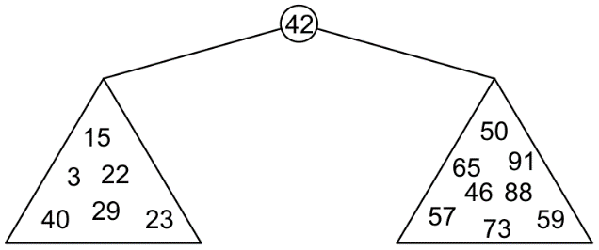
Binary Search Trees
Graphically, we may show the relationship as
Each of the two sub-trees will themselves be binary search trees

Slide 155
Definition
Thus, we define a non-empty binary search tree as a binary tree with the following properties:
The left sub-tree (if any) is a binary search tree and all elements are less than the root element, and
The right sub-tree (if any) is a binary search tree and all elements are greater than the root element

Slide 156
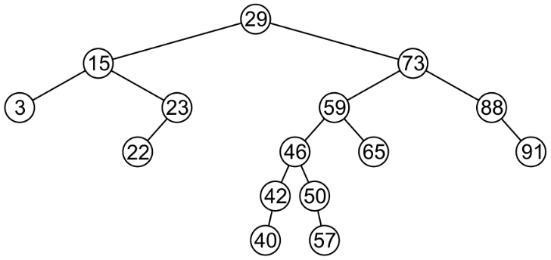
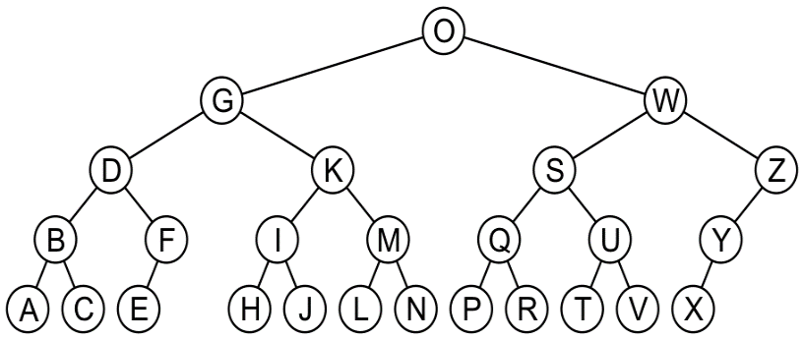
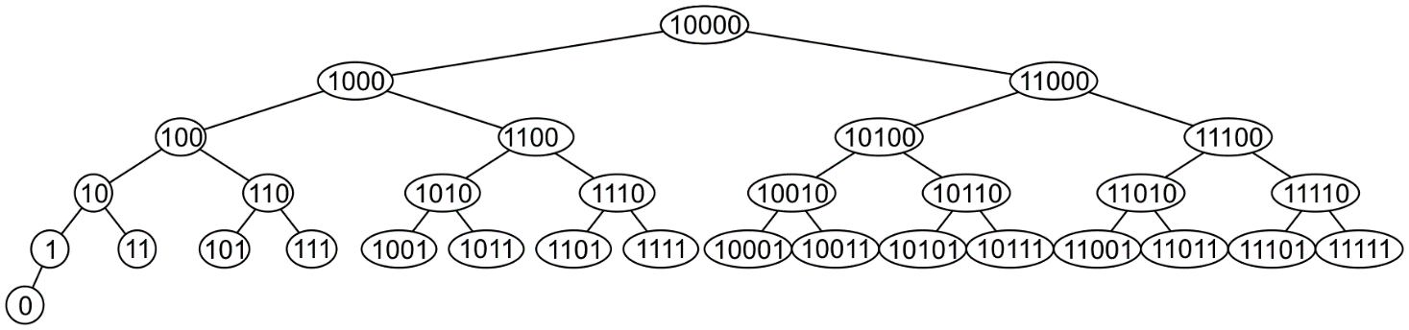
Examples
Here are other examples of binary search trees:

Slide 157
46 | 23 | 40 | 65 | 15 | 88 | 57 | 3 | 50 | 91 | 73 | 59 | 22 | 29 | 42
29 | 73 | 88 | 15 | 23 | 22 | 59 | 3 | 91 | 46 | 50 | 42 | 40 | 57 | 65
3 | 15 | 22 | 23 | 29 | 40 | 42 | 46 | 50 | 57 | 59 | 65 | 73 | 88 | 91
3 | 50 | 46 | 29 | 40 | 65 | 15 | 42 | 57 | 22 | 23 | 59 | 73 | 91 | 88

Slide 158
46 | 23 | 40 | 65 | 15 | 88 | 57 | 3 | 50 | 91 | 73 | 59 | 22 | 29 | 42
29 | 73 | 88 | 15 | 23 | 22 | 59 | 3 | 91 | 46 | 50 | 42 | 40 | 57 | 65
3 | 15 | 22 | 23 | 29 | 40 | 42 | 46 | 50 | 57 | 59 | 65 | 73 | 88 | 91
3 | 50 | 46 | 29 | 40 | 65 | 15 | 42 | 57 | 22 | 23 | 59 | 73 | 91 | 88

Slide 159
46 | 23 | 40 | 65 | 15 | 88 | 57 | 3 | 50 | 91 | 73 | 59 | 22 | 29 | 42
29 | 73 | 88 | 15 | 23 | 22 | 59 | 3 | 91 | 46 | 50 | 42 | 40 | 57 | 65
3 | 15 | 22 | 23 | 29 | 40 | 42 | 46 | 50 | 57 | 59 | 65 | 73 | 88 | 91
3 | 50 | 46 | 29 | 40 | 65 | 15 | 42 | 57 | 22 | 23 | 59 | 73 | 91 | 88

Slide 160
46 | 23 | 40 | 65 | 15 | 88 | 57 | 3 | 50 | 91 | 73 | 59 | 22 | 29 | 42
29 | 73 | 88 | 15 | 23 | 22 | 59 | 3 | 91 | 46 | 50 | 42 | 40 | 57 | 65
3 | 15 | 22 | 23 | 29 | 40 | 42 | 46 | 50 | 57 | 59 | 65 | 73 | 88 | 91
3 | 50 | 46 | 29 | 40 | 65 | 15 | 42 | 57 | 22 | 23 | 59 | 73 | 91 | 88

Slide 161
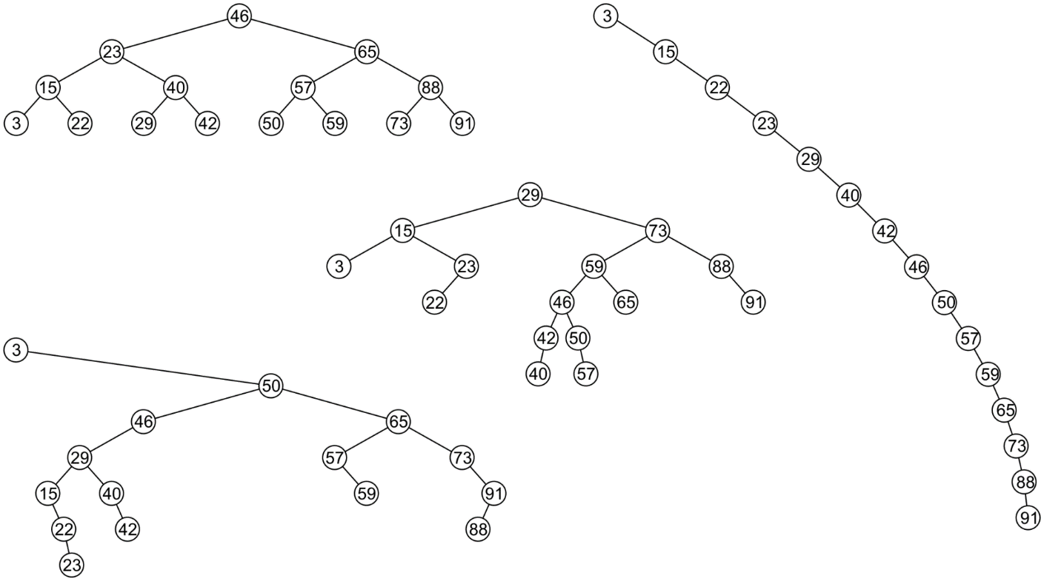
Examples
All these binary search trees store the same data

Slide 162
Duplicate Elements
We will assume that in any binary tree, we are not storing duplicate elements unless otherwise stated
In reality, it is seldom the case where duplicate elements are stored as separate entities

Slide 163
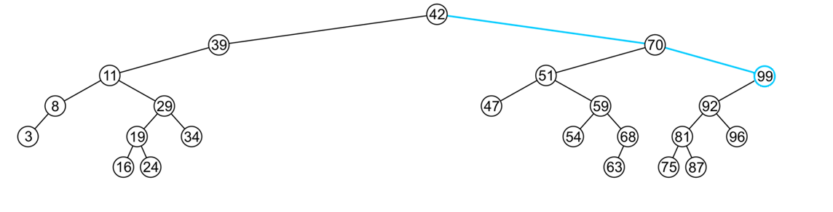
Finding the Max/Min Object
The run time O(h)
The extreme values (max/min) are not necessarily leaf nodes
Notes:
163

Slide 164
Binary Search Approximation
What is Binary Search Approximation? (Approximate binary search)
Given a set of keys and a sorted (non-decreasing) vector of values, use a binary search to find the indexes in values that match the values of key. This implementation allows for returning the index of the nearest match if there are no exact matches. It also allows specifying a tolerance for comparison of doubles.
Approximation in Binary Search:
Consider the children's game "guess a number." The scorer has a secret number, and will only tell the player if their guessed number is higher than, lower than, or equal to the secret number. The player then uses this information to guess a new number. But the upper bound and lower bound is not known.

Slide 165
Dictionaries

Slide 166
Dictionaries
Dictionaries store elements so that they can be located quickly using keys.
A dictionary may hold bank accounts
Account number
Current balance,
Details of account holder, and
Transaction History
Banking Operation by using account number as a search key

Slide 167
Example
Suppose we have a system which is associated with approximately 150 error conditions where
Each of which is identified by an 8-bit number from 0 to 255, and
When an identifier is received, a corresponding error-handling function must be called
We could create an array of 150 function pointers and to then call the appropriate function….
Unfortunately, this is slow—we would have to do some form of binary search in order to determine which of the 150 slots corresponds to,
for example, error-condition identifier id = 198
If there was a possibility of dynamically adding new error conditions or removing some error conditions, this would substantially increase the effort required…
A better solution:
Create an array of size 256
Is the increased speed worth the allocation of additional memory?

Slide 168
keys
Our goal:
Store data so that all operations are O(1) time
Use Array to store, and array index as the key to search
Use List to store, and Binary Search to search a key
Requirement:
The memory requirement should be O(n)
Solution:
Hashing

Slide 169
Hashing
A hash table is a data structure for storing a set of items, so that we can quickly determine whether an item is or is not in the set.
The process of mapping an object or a number onto an integer in a given range is called hashing
Problem: multiple objects may hash to the same value
Such an event is termed a collision
Hash tables use a hash function together with a mechanism for dealing with collisions
The ultimate goal is to map onto an integer range 0, 1, 2, ..., M – 1

Slide 170
Analysis of Hashing
An ideal hash function would pick a slot, uniformly at random and hash the key to it with No Collision.
However, this is not a hash function since we would not know which slot to look into when searching for a key.
For our analysis we will use this simple uniform hash function
If choosing a hash function uniformly at random, makes every hash value equally likely for every item in the universe
Given hash table T with m slots holding n elements, the load factor is defined as α=n/m
An good hash function is one which distributes keys evenly (Uniform Distribution) amongst the slots.
A “good” hash function minimizes the probability of collisions

Slide 171
Analysis of Hashing
Perfect Hashing
Perfect Hashing Guarantees NO COLLISION, but it requires that all the keys are known in advance and that there are relatively few of them.
Universal Hashing
If for any two items in the universe, the probability of collision is as small as possible.

Slide 172
Types of hash functions
We will look at two classes of hash functions
Predetermined hash functions (explicit)
The easiest solution is to give each object a unique number, For example:
an auto-incremented static member variable
All BITS Non Specific student have two hash values:
BITS ID Number
Employee ID Number
Arithmetic hash functions (implicit)
An arithmetic hash value is a deterministic function that is calculated from the relevant member variables of an object
Rational numbers, and
Strings
Hashing uses the numeric keys only.

Slide 173
The hash process
Object
32-bit integer
Modulus, mid-square, multiplicative, Fibonacci
Map to an index (0, ..., (M – 1))
Deal with collisions
Chained hash tables
Open addressing
Linear probing
Quadratic probing
Double hashing

Slide 174
Hash Function (revisited)
Need to choose a good hash function
Quick to compute
Deterministic (Regenerate the same hash, as of insert, while lookup)
Distributes keys uniformly throughout the table
Good hash functions are very rare–birthday paradox
Continuous (Neighbourhood Numbers are Hashed in Neighbourhood only)?
Non-Invertible (should not be able to, construct the original key from hash value)
How to deal with hashing non-integer keys:
Find some way of turning keys into integers
e.g. remove hyphen in 9635-8904 to get 96358904!
For a string, add up ASCII values of the characters of your string
Then use standard hash function on the integers

Slide 175
Popular Hash-Code Maps
Integer cast: for numeric types with 32 bits or less, we can reinterpret the bits of the number as an int
Component sum: for numeric types with more than 32 bits (e.g., long and double), we can add the 32-bit components.
Polynomial accumulation: for strings of a natural language, combine the character values (ASCII or Unicode) a₀a₁... a_{n-1} by viewing them as the coefficients of a polynomial: a₀+ a₁x+ ...+ x_{n-1}a^{n-1}
The polynomial is computed with Horner’s rule, ignoring overflows, at a fixed value x:
a₀+ x(a₁ +x(a₂+ ... x(a_{n-2}+ xa_{n-1}) ... ))
The choice x = 33, 37, 39, or 41 gives at most 6 collisions on a vocabulary of 50,000 English words

Slide 176
Compression Maps
Use the remainder
h(k) = k mod m, k is the key, m the size of the table
Need to choose m
m = b^{e}(bad)
if m is a power of 2, h(k) gives the e least significant bits of k
all keys with the same ending go to the same place
m prime(good)
helps ensure uniform distribution
primes not too close to exact powers of 2

Slide 177
Why Prime
Primes are unique numbers, the product of a prime with any other number has the best chance of being unique (not as unique as the prime itself of-course) due to the fact that a prime is used to compose it. This property is used in hashing functions.
If you choose a prime for the size of the table such a common factor is highly unlikely.
If the data is random then there’s no need for a prime number.
Used to keep collisions uniform when the population being hashed exhibits certain mathematical characteristics like being a multiple of a certain number e.g a population of all even numbers.

Slide 178
Why Prime
Concept of Equivalence Class??
“Every key in K that shares a common factor with the number of buckets m will be hashed to a bucket that is a multiple of this factor”
So what can be the solution?
We just have to minimize the number of common factors between m and the elements of K. That's why we have to use prime numbers because it has very few factors. A large prime number is the best solution.
Using prime number reduces the count of collisions, since highly frequent number won't have prime number as its multiple.
Picking a big enough, non-power-of-two number will make sure the hash function really is a function of all the input bits, rather than a subset of them.

Slide 179
Alternate to collision (Chaining)
Separate chaining
Each bucket is independent, and uses some Additional Secondary Data Structure (list of entries with the same index)
Link List
Self Balancing Binary Search Tree
Separate chaining with list head cells
Dynamic array
For separate-chaining, the worst-case scenario is when all entries are inserted into the same bucket
Chained hash tables also inherit the disadvantages of linked lists.

Slide 180
Alternate to collision (probing, double hashing)
Open Addressing
(The name "open addressing" refers to the fact that the location of the item is not determined by its hash value, and it does not uses Secondary Data Structure)
All elements are stored in the hash table, i.e., n ≤ m
Each table entry contains either an element or null
When searching for an element, systematically probe table slots
Modify hash function to take the probe number i as the second parameter
h: U X {0,1,2,……..m-1} -> {0,1,2,……m-1}
Hash function, h, determines the sequence of slots examined for a given key
Probe sequence for a given key k given by
<h(k,0), h(k,1), h(k,2),……. h(k,m-1)> - a permutation <0,1,…m-1>

Slide 181
Linear Probing
If the current location is used, try the next table location LinearProbingInsert(k)
if(tableisfull)error
probe=h(k)
while(table[probe]occupied)
probe=(probe+1)mod m
table[probe]=k
Uses less memory than chaining as one does not have to store all those links
Slower than chaining since one might have to walk along the table for a long time

Slide 182
Linear Probing
h(k) = k mod 13
insert keys: 18 41 22 44 59 32 31 73
 |  | 18 | 41 | 22 | 44 | 59 | 32 | 31 | 73
 |  |  |  |  | 31
 |  |  |  |  |  |  |  | 73
 |  |  |  |  | 44 | 32
 |  | 41 |  |  | 18 | 44 | 59 | 32 | 22 | 31 | 73
0 | 1 | 2 | 3 | 4 | 5 | 6 | 7 | 8 | 9 | 10 | 11 | 12

